Slide 2

Agile Software Engineering
Lecture 4

Slide 3
Course Lecture Schedule
Date | Topic | Book Chapter(s)
Wed 8.9. | Course introduction
Tue 14.9. | Introduction to Software Engineering | Chapter 1
Tue 21.9. | Software Processes | Chapter 2
Mon 27.9 | Agile Software Engineering | Chapter 3
Tue 5.10. | Requirements Engineering | Chapter 4
Mon 11.10. | Architectural Design | Chapter 6
Wed 20.10. | Modeling and implementation | Chapters 5 & 7
Mon 1.11. | Testing & Quality | Chapters 8 & 24
Mon 8.11. | Software Evolution & Configuration Management | Chapters 9 & 25
Mon 15.11. | Software Project Management | Chapter 22
Mon 22.11. | Software Project Planning | Chapter 23
Mon 29.11. | Global Software Engineering
Wed 8.12. | Software Business
Mon 13.12. | Last topics
Teachers:
Maria
Susan
Sami Hyrynsalmi

Slide 4
GoaLs for This lecture:
After this lecture, you know
What is agile software engineering
The basics of Scrum and XP
What is Lean software engineering

Slide 5
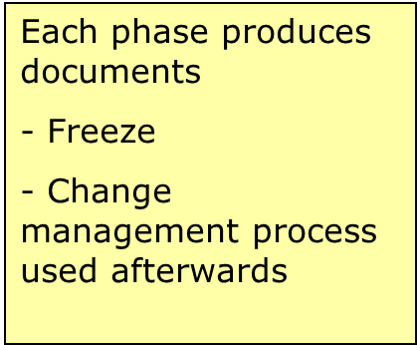
Waterfall
Feasibility
study
User
requirements
The whole application is developed in one go
Planning and control
Document driven
Limited scope for iteration
Different people in different phases
Analysis
System
design
Program
design
Coding
Testing
Operation

Slide 6
Iterative and Incremental Development
The concept of growing a system via iterations: iterative and incremental development (IID)
Divide the project into increments
Each increment adds functionality
Each iteration is a self-contained mini project composed of activities such as requirements analysis, design, programming and test
At the end of the iteration an iteration release: a stable integrated and tested partially complete system
Most releases internal, final iteration release is the complete product
Prioritize user requirements
MOSCOW priorities: must, should, could, want
High-priority requirements into early increments
Freeze requirements during each increment

Slide 7
Timeboxing
Plan A:
project’s outcome if
everything goes fine
Plan B:
project’s outcome if
everything does not go fine
Prioritize features
Make a release plan
Plan the contents of the first timebox
Dates fixed
Content flexible
Release 5
Release 4
Release 3
Release 2
Release 1
Starting
date
Predefined
Delivery date

Slide 8

Agile
What comes to your mind when you hear term “Agile”?
Discuss with your pair
History of Lean and Agile (7 min): https://www.youtube.com/watch?v=WKIy8nssMQc

Slide 9
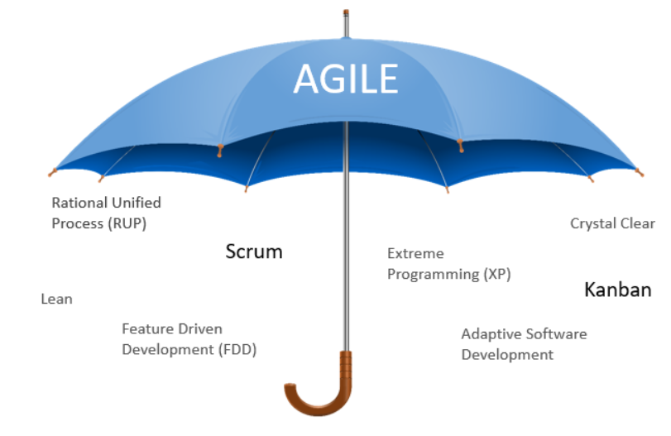
Agile Methods
Agile - ability to create and respond to change.
Several Methods under one “Umbrella”
According to Agile Alliance: “Agile software development is an umbrella term for a set of frameworks and practices based on the values and principles expressed in the Manifesto for Agile Software Development and the 12 Principles behind it.”
Originally designed for small, under 50 person projects
Nowadays also big organizations take into use – Scaling methods (e.g. LeSS, SAFe, DAD, Spotify model)

Slide 10
Agile Manifesto
Origins of Agile?
Agile manifesto in 2001
4 values and 12 principles
Agile culture and thinking more important than the practices
https://www.smartsheet.com/comprehensive-guide-values-principles-agile-manifesto

Slide 11
12 Principles

Slide 12
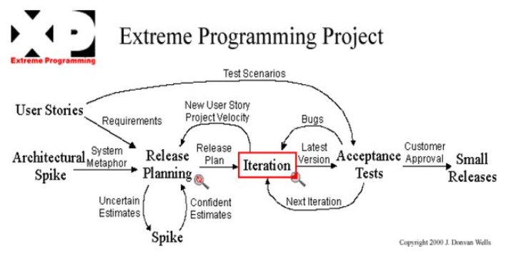
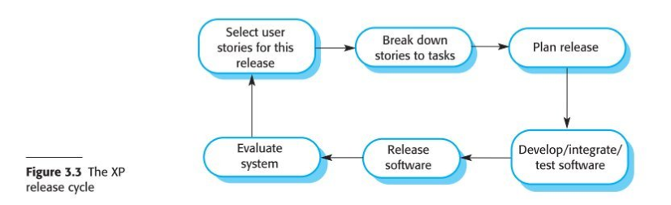
XP – Extreme Programming
Kent Beck, 1998
Short video: https://www.youtube.com/watch?v=kFM2Vcu-BRo

Slide 13
XP – Extreme Programming
Introduced a number of Agile practices:
Collective ownership – all developers responsible of code, anyone can change anything
Continuous integration – integrate as soon as a task is complete, tests need to pass
Incremental planning – Stories and tasks
On-site customer – available and member of the team
Pair programming – navigator & observer
Refactoring – improve the code continuously
Simple design – enough, no more
Small releases – minimal set first that provides business value
Sustainable pace – no large overtime
Test first development – write tests first for a new piece of functionality

Slide 14
Scrum
Iterative and incremental agile software development framework for managing product development
Process framework
not a process, technique, or definitive method
every team must decide the specific tactics for using Scrum
The most used Agile Method in the industry at the moment
Does not cover design, implementation, or concrete testing practices

Slide 15
Introduction to Scrum
https://youtu.be/9TycLR0TqFA

Slide 16
Scrum

Slide 17
Scrum Roles

Slide 18







Scrum team = Developers + Scrum Master + Product Owner
Self-organizes to do the work of delivering a potentially releasable increment of “Done” product at the end of each Sprint

Slide 19
Scrum Team
Develops the product and provides ideas to the Product Owner about how to make the product great
7 ± 2 people
Is cross-functional (includes all expertise necessary to deliver a potentially shippable product each sprint)
Is self-managing: high degree of autonomy and accountability
Besides the Scrum Master and Product Owner, everyone else is Developer, no other roles
Members full-time in the team

Slide 20

Scrum Master
Ensures that the Scrum Team understands and uses Scrum:
Studies, plans, teaches and ensures the application of Scrum: both values and practices
Prepares and leads the Scrum events
Manages team building
communication channels, team spirit
Initiates discussions on any problems,
If the team does not react, e.g. overseeing that team learns to proceed the project on their own
Ensures that the team is fully functional and productive
Coaches the team to their best possible performance
Helps improve team productivity in any way possible
Enables close cooperation across all roles and functions
Shields the team from external interferences
Helps to remove impediments

Slide 21

Product Owner
Is responsible for maximizing return on investment (ROI), thus has the final authority
Profitability of the product
Identifies product features
Prioritizes the features according to the market value
Adjust features and priority every iteration, as needed
Interacts regularly with the team, e.g., reviews the Sprint results
Participates into Sprint Planning and Sprint Reviews
Accepts or rejects work results

Slide 22
Scrum Artifacts
Represent work or value
Are designed to maximize transparency of key information
Artifacts:
Product Backlog - ordered list of what is needed to improve the product
Sprint Backlog - is composed of the Sprint Goal (why), the set of Product Backlog items selected for the Sprint (what), as well as an actionable plan for delivering the Increment (how)
Increment - a concrete stepping stone toward the Product Goal

Slide 23
Backlog Items
Often three types
Epic
Feature
User story
In a backlog management tool
E.g. Jira
Size estimates
Story points (e.g. Fibonacci numbers: (0), 1, 2, 3, 5, 8, 13, 21…)
T-shirt sizes: S, M, L

Slide 24
Scrum Events
The Sprint
Sprint planning
Daily Scrum
Sprint Review
Sprint retrospective

Slide 25
Sprint
Fixed length – one month or less
During the Sprint:
No changes are made that would endanger the Sprint Goal;
Quality does not decrease;
The Product Backlog is refined as needed; and,
Scope may be clarified and renegotiated with the Product Owner as more is learned.

Slide 26
Sprint Planning
Initiates the Sprint by laying out the work to be performed for the Sprint
The resulting plan is created by the collaborative work of the entire Scrum Team
Topics:
Why is this Sprint valuable? – Sprint goal
What can be DONE this sprint? – Estimate & select items
How will the chosen work get done?
Max 8 hours for one month sprint

Slide 27






Daily Scrum / (Daily Stand-up)
Participants: Developers (Scrum Master & Product Owner optional)
Goal: Update, coordinate, adjust – not a status reporting to anybody else
Max 15 min
Suggestion: each member tells the other team members:
What has been accomplished since the last meeting?
What will be done before the next meeting?
What obstacles are in the way?
If discussion needed: follow-up meetings agreed and held afterwards
15 min
3 Questions

Slide 28
Sprint Review
The purpose: to inspect the outcome of the Sprint and determine future adaptations.
The Scrum Team presents the results of their work to key stakeholders and progress toward the Product Goal is discussed
What to do next?
Product Backlog may be adjusted
Max 4 hours for one month Sprint

Slide 29
Sprint Retrospective
Inspection and adaption related to the process and environment
Participants: Scrum Team
Team discusses what’s working and what’s not working and agree on changes to try
Usually the Scrum Master facilitates
Different techniques, try different ones!
Keep
Drop
Try
21.9.2016

Slide 30
Lean Software Development
Origins from manufacturing – Toyota Production System
Reduced in-process and final inventories
Optimizes the flow
“Pull” instead of “push”
Mary and Tom Poppendieck’s book: Lean Software Development, 2003
7 principles of Lean Software Development:
Optimize the whole
Eliminate waste
Build quality in
Learn constantly
Deliver fast
Engage everyone
Keep getting better

Slide 31
Lean Software Development
Origins from manufacturing – Toyota Production System
Reduced in-process and final inventories
Optimizes the flow
“Pull” instead of “push”
Mary and Tom Poppendieck’s book: Lean Software Development, 2003
7 principles of Lean Software Development:
Optimize the whole
Eliminate waste - unnecessary features, lost knowledge, partially done work, handovers…
Build quality in
Learn constantly – explore options & delay critical decisions to the last responsible moment, and then make decisions based on the best available knowledge at the time & get feedback
Deliver fast
Engage everyone
Keep getting better – practices are a starting point, adapt & improve them

Slide 32
Difference between Lean and Agile
https://www.youtube.com/watch?v=aUd3xTdtXqI

Slide 33
Essay 3: Comparison of Agile and Lean
Write a 750 word essay describing and comparing Agile and Lean software development. Describe the basics of each. In particular, discuss how Agile (e.g. Scrum) and Lean could support each other. While discussing, you can bring in your own opinions, however, remember to state clearly which statement is your opinion and which is based on material (e.g. you can say: “In my opinion…” or “I think that….” or “Based on my experience…”.
Use the reading materials (textbook, articles, slides). You may use additional materials (that you have found by yourself), as well.
Use referencing according to the guidelines, and try to aim for the 750-word limit. Too short or overly long essays will receive a lower score. For the highest score, your essay should be within the 560-940 word range (within 25%).
Reference list is NOT included in the word limit
Remember the importance of referencing, and of avoiding plagiarism.

Slide 34
Essay will be graded on:
Having all the expected elements: description of the methods and discussion on how Lean and Agile can support each other.
The quality and understanding shown in the descriptions and discussion.
The length, as described above
The correct use of referencing. Note that absence of references fails the essay completely, as you are required to reference)
An overall assessment of the essay quality

Slide 35

Questions?

